Slide 1




Slide 2
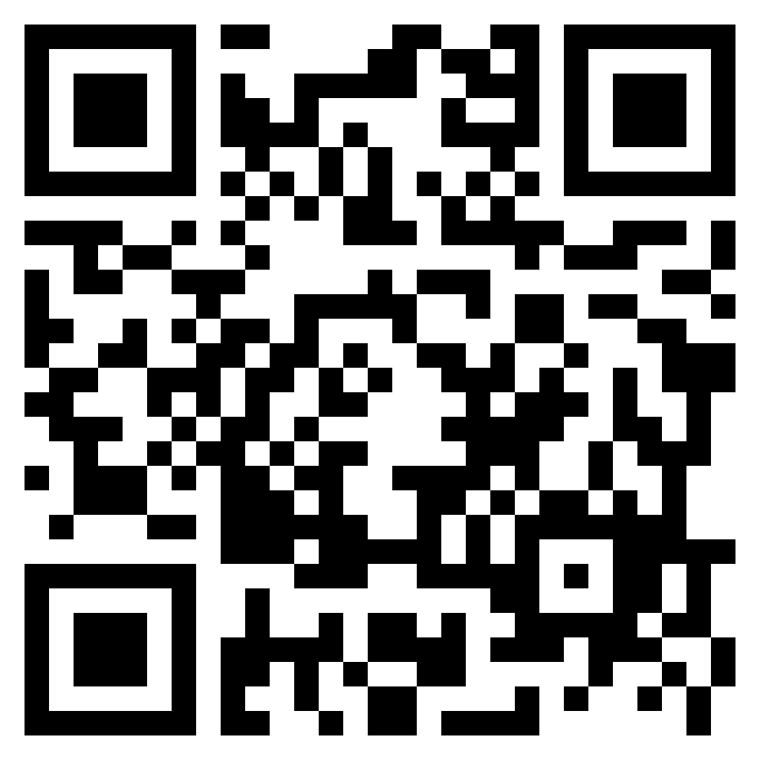
TEST TIME ON ADDITION AND SUBTRACTION SHORTCUTS
URL: https://forms.gle/LwV4upuFRDcHeECG9
QR CODE:

Slide 3

SQUARES AND SQUARE ROOTS-1

Slide 4
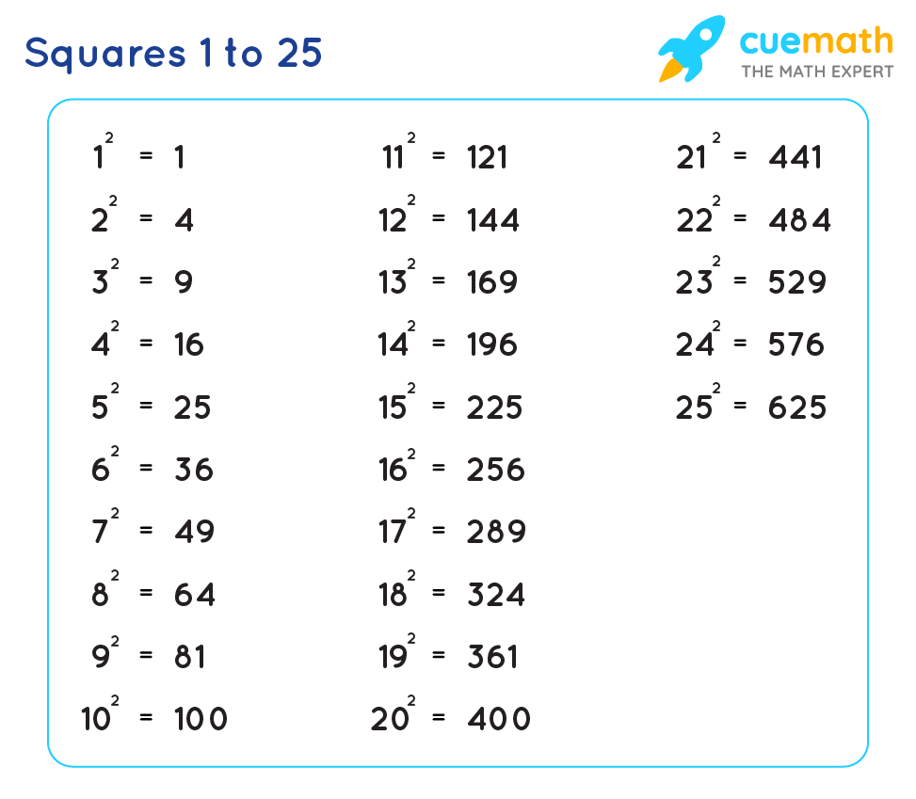
Question: 01
Question: 01
SQUARES AND SQUARE ROOTS

Slide 5
SQUARES AND SQUARE ROOTS
Squares from 25-75
49^2
Step 1. Take the difference of given number by 25.
49~25=24
Step 2. Take the difference of given number by 50 and find the square of that number.If square is single digit number add 0 before it.
50~49=1 & 1^2=1 Hence it is single digit => 01 is result
Step 3. Place the result from Step 2 next to the result from Step 1: 2401.
Notes:
Answer: C
Explanation:
Each letter in the word is moved one step backward to obtain the corresponding letter of the code.

Slide 6
SQUARES AND SQUARE ROOTS
Squares from 25-75
40^2
Step 1. Take the difference of given number by 25.
40~25=15
Step 2. Take the difference of given number by 50 and find the square of that number. If Square is three digit number add 1st digit of square to the result of step1.
50~40=10 & 10^2=100 Hence it is three digit add 1 to 15 => result of step1 is 16
Step 3. Place the result from Step 2 next to the result from Step 1: 1600.
Notes:
Answer: C
Explanation:
Each letter in the word is moved one step backward to obtain the corresponding letter of the code.

Slide 7
SQUARES AND SQUARE ROOTS
Squares from 76-125
99^2
Step 1. Take the difference of given number by 100. And find square, If it is single digit add 0 before it.
100~99=1 => 01.
Step 2. Subtract the result of 1st step from given number.
99-1=98.
Step 3. Place the result from Step 1 next to the result from Step 2: 9801
Notes:
Answer: C
Explanation:
Each letter in the word is moved one step backward to obtain the corresponding letter of the code.

Slide 8
SQUARES AND SQUARE ROOTS
Squares from 76-125
76^2
Step 1. Take the difference of given number by 100. And find square, If it is three digit number add the first digit to result of step 2.
100~76=24 => 576. after giving 5 to step 2, number is 76.
Step 2. Subtract the result of 1st step from given number.
76-24=52. Hence result of step 1 is 576, 52+5=57.
Step 3. Place the result from Step 1 next to the result from Step 2: 5776.
Notes:
Answer: C
Explanation:
Each letter in the word is moved one step backward to obtain the corresponding letter of the code.

Slide 9
SQUARES AND SQUARE ROOTS
Finding the square root of perfect squares
EXAMPLE: Find the square root of 7056?
We pair the digits up starting from the right side. Since there is one extra left over after two pairs are formed,we club it with the pair closest to it.
Unit digit will be 4 or 6
Since, 64<70<81, so the square root will definitely be 84 or 86.
Now consider 8 and 9 =>8*9=72>70
Since 70 is lesser the 72, ,we pick the lesser of the options i.e. 84
Answer: 84
Notes:
Answer: C
Explanation:
Each letter in the word is moved one step backward to obtain the corresponding letter of the code.

Slide 10
Question: 01
Find the square root of 4489
67
63
53
57
Answer : A
Notes:
Answer: C
Explanation:
Each letter in the word is moved one step backward to obtain the corresponding letter of the code.

Slide 11
Explanation: 01
We group the last pair of digits, and the rest of the digits together.
Now, since the unit digit of 4489 is 9. So we can say that unit digit of its square root will be either 3 or 7.
Now consider first 2 digits i.e. 44. Since 44 comes in between the squares of 6 and 7 (i.e. 36<44<49),so we can say that the tens digit of the square root of 4489 will be 6. So far we can say that the square root will be either 63 or 67.
Now we can fix the exact unit digit.
To find the exact unit digit, we consider the tens digit i.e. 6 and the next term i.e.7
Multiply these 2 terms 6*7=42, Since 44 is greater than 42. So square root of 4489 will be the bigger of the two options i.e. 67
Answer : B
Notes:
Answer: C
Explanation:
Each letter in the word is moved one step backward to obtain the corresponding letter of the code.

Slide 12
Question: 02
Find the square root of 33489 ?
173
177
183
187
Answer : c
Notes:
Answer: C
Explanation:
Each letter in the word is moved one step backward to obtain the corresponding letter of the code.

Slide 13
Explanation: 02
We pair the digits up starting from the right side. Since there is one extra left over after two pairs are formed,we club it with the pair closest to it.
Unit digit will be 3 or 7
Since, 18^2<334<19^2, so the square root will definitely be 183 or 187.
Now consider 18 and 19 =>12*13=342<334
Since 334 is lesser than 342, we pick the lesser of two numbers i.e. 183
Notes:
Answer: C
Explanation:
Each letter in the word is moved one step backward to obtain the corresponding letter of the code.

Slide 14
Question: 03
Find the square root of a 1.8225?
1.45
1.35
1.25
1.15
Answer : B
Notes:
Answer: C
Explanation:
Each letter in the word is moved one step backward to obtain the corresponding letter of the code.

Slide 15

Explanation: 03
Notes:
Answer: C
Explanation:
Each letter in the word is moved one step backward to obtain the corresponding letter of the code.

Slide 16

Question: 04
Find the square root of
7/6
1/2
6/7
2/3
Answer : A
Notes:
Answer: C
Explanation:
Each letter in the word is moved one step backward to obtain the corresponding letter of the code.

Slide 17

Explanation: 04
Notes:
Answer: C
Explanation:
Each letter in the word is moved one step backward to obtain the corresponding letter of the code.

Slide 18
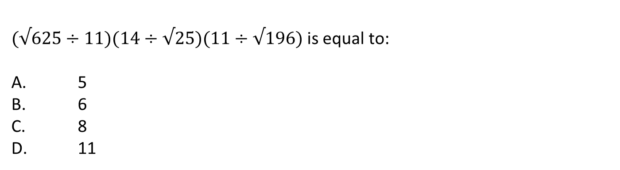
Question: 05
Answer : A
Notes:
Answer: C
Explanation:
Each letter in the word is moved one step backward to obtain the corresponding letter of the code.

Slide 19
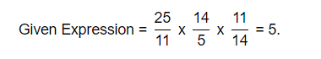
Explanation: 05
Notes:
Answer: C
Explanation:
Each letter in the word is moved one step backward to obtain the corresponding letter of the code.

Slide 20
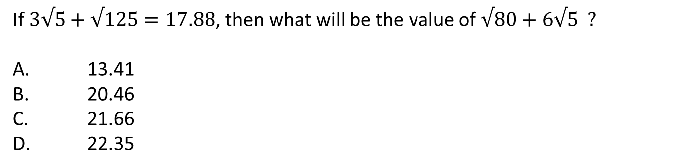
Question: 06
Answer : D
Notes:
Answer: C
Explanation:
Each letter in the word is moved one step backward to obtain the corresponding letter of the code.

Slide 21
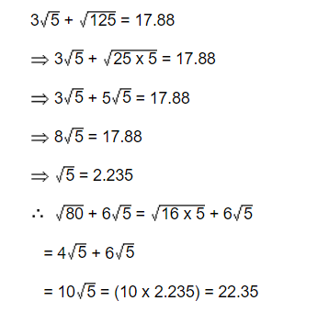
Explanation: 06
Notes:
Answer: C
Explanation:
Each letter in the word is moved one step backward to obtain the corresponding letter of the code.

Slide 22
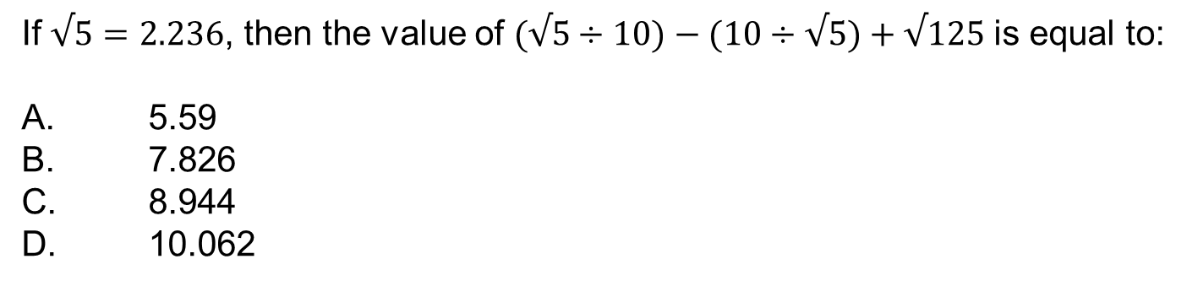
Question: 07
Answer : B
Notes:
Answer: C
Explanation:
Each letter in the word is moved one step backward to obtain the corresponding letter of the code.

Slide 23
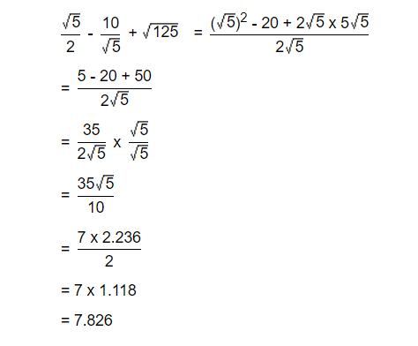
Explanation: 07
Notes:
Answer: C
Explanation:
Each letter in the word is moved one step backward to obtain the corresponding letter of the code.

Slide 24
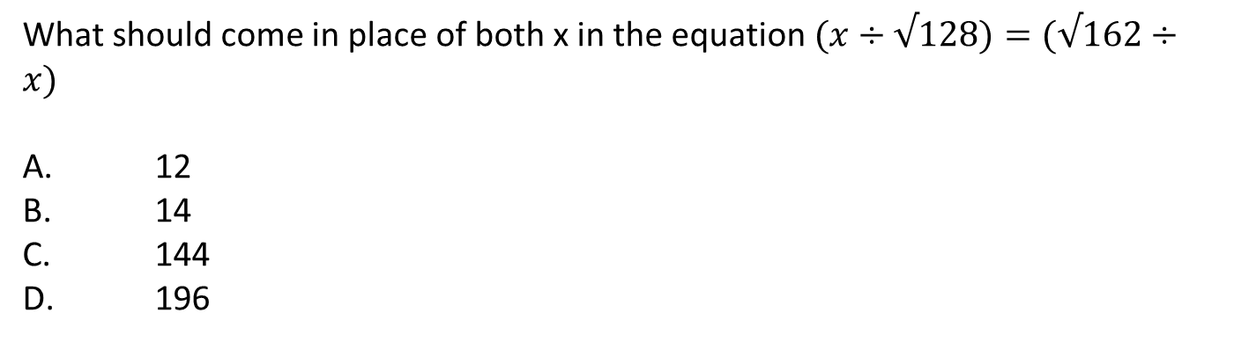
Question: 08
Answer : A
Notes:
Answer: C
Explanation:
Each letter in the word is moved one step backward to obtain the corresponding letter of the code.

Slide 25
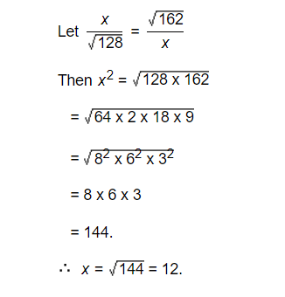
Explanation: 08
Notes:
Answer: C
Explanation:
Each letter in the word is moved one step backward to obtain the corresponding letter of the code.

Slide 26
Question: 09
If √2 = 1.414 then find the value of √20,000 + √200 = ?
152.76
153.46
155.54
165.56
Answer : C
Notes:
Answer: C
Explanation:
Each letter in the word is moved one step backward to obtain the corresponding letter of the code.

Slide 27
Explanation: 09
√2 = 1.414 =>
√20000 = 141.4
√200 = 14.14
Adding these two, we get 155.54
Notes:
Answer: C
Explanation:
Each letter in the word is moved one step backward to obtain the corresponding letter of the code.

Slide 28
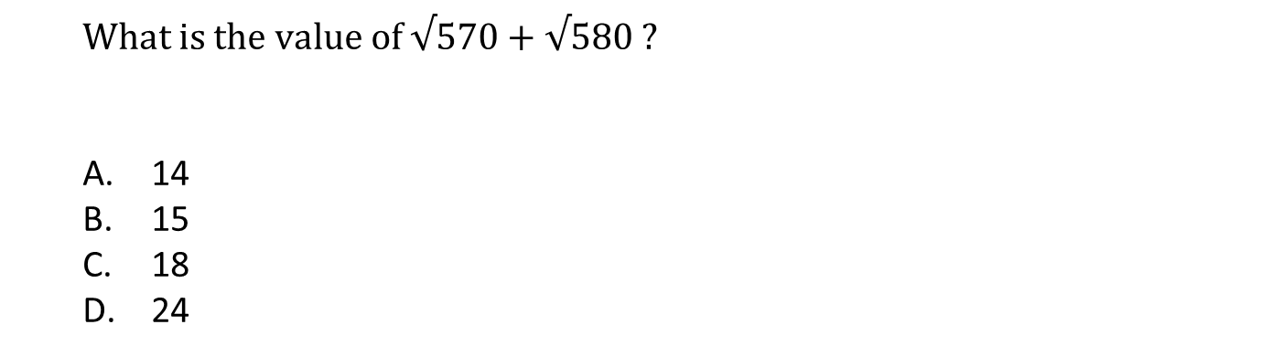
Question: 10
Answer : B
Notes:
Answer: C
Explanation:
Each letter in the word is moved one step backward to obtain the corresponding letter of the code.

Slide 29
Explanation: 10
Given exp. = √176 + 49 = √225 = 15
Notes:
Answer: C
Explanation:
Each letter in the word is moved one step backward to obtain the corresponding letter of the code.

Slide 30
Question: 11
√484 + √529 =?
43
47
45
24
Answer : C
Notes:
Answer: C
Explanation:
Each letter in the word is moved one step backward to obtain the corresponding letter of the code.

Slide 31
Explanation: 11
Given exp. = √176 + 49 = √225 = 15
Notes:
Answer: C
Explanation:
Each letter in the word is moved one step backward to obtain the corresponding letter of the code.

Slide 32
Question: 12
What approximate value will come (?) in the following equation?
84.95% of 280 + √? = 253.001
256
324
18
225
Answer : D
Notes:
Answer: C
Explanation:
Each letter in the word is moved one step backward to obtain the corresponding letter of the code.

Slide 33
Explanation: 12
253.001=253, 84.95% of 280 + √? =253. Hence, answer is 225.
Notes:
Answer: B
Explanation:
Reverse the word and move each letter –1. Reverse of FISH is HSIF subtract 1 from each letter of HSIF. So code of FISH become GRHE.

Slide 34
Question: 13
How many natural number lie between the square of the following numbers 12 and 13.
24
23
25
26
Answer : A
Notes:
Answer: A
Explanation:
Each letter moves +1, -1, ....alternately except for L, which is –4. We have to find the word for the code IFWJBP. Add 4 to I then -1, +1 alternately to the remaining letters. The word will be MEXICO.

Slide 35
Explanation: 13
We know that between n^2 and (n+1)^2 there are 2n non-perfect square numbers. So, between 12^2 and 13^2, there are 2(12) , that is 24 natural numbers.
Notes:
Answer: B
Expalantion:
Reverse the word and +1 to each letter. The reverse of CHILDREN is NERDLIHC. add 1 to each letter. Therefore, the code of CHILDREN becomes OFSEMJID.

Slide 36
Question: 14
Evaluate √(0.0169* ?) = 1.3
10
100
1000
None of these
Answer : B
Notes:
Answer: D
Explanation:
Each letter in the word is moved one step forward and the first letter of the group so obtained is put at the end, to obtain the code.

Slide 37
Explanation: 14
Let √(0.0169 * ?)= 1.3
Then, 0.0169 * ?=(1.3)^2 = 1.69
=>?=1.69/0.0169
?= 100
Notes:
Answer: D
Explanation:
The small letters are b, d, f, h, j, l, n, p, r, t, v, x, z. The third day from tuesday will be friday and code will be frIdAY.

Slide 38
Question: 15
The least perfect square, which is divisible by each of 21, 36 and 66 is:
213444
214344
214434
231444
Answer : A
Notes:
Answer: B
Explanation:
Letters are arranged according to the digital sum roots
A = 1, B = 2, ..... ,H=8, I = 9, J = 10=1+0=1,M= 13= 1+3=4 & so on.
Similarly, code for MATHEMATICS is 4 1 2 8 5 4 1 2 9 3 1.

Slide 39
Explanation: 15
L.C.M. of 21, 36, 66 = 2772.
Now, 2772 = 2 x 2 x 3 x 3 x 7 x 11
To make it a perfect square, it must be multiplied by 7 x 11.
So, required number = 2² x 3² x 7² x 11² = 213444
Notes:
Answer: C
Explanation:
Last letter is ‘Y’.

Slide 40




THANK YOU
+91 78150 95095
codemithra@ethnus.com
www.codemithra.com

Slide 41








/ethnuscodemithra
Ethnus Codemithra
/ethnus
/code_mithra
THANK YOU
https://learn.codemithra.com/
codemithra@ethnus.com
+91 7815 095 095
+91 9019 921 340

